Slide 1

Telemedicine
PAYAL CHAND
CID: 06067958
GROUP 19
Problem Statement:
How might we help children with obesity-linked asthma overcome fear of breathlessness and re-engage with physical play and confidence, while reassuring parents and carers through telemedicine?

Slide 2
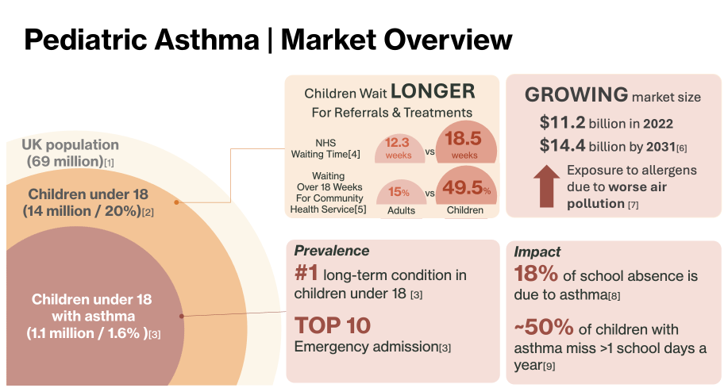
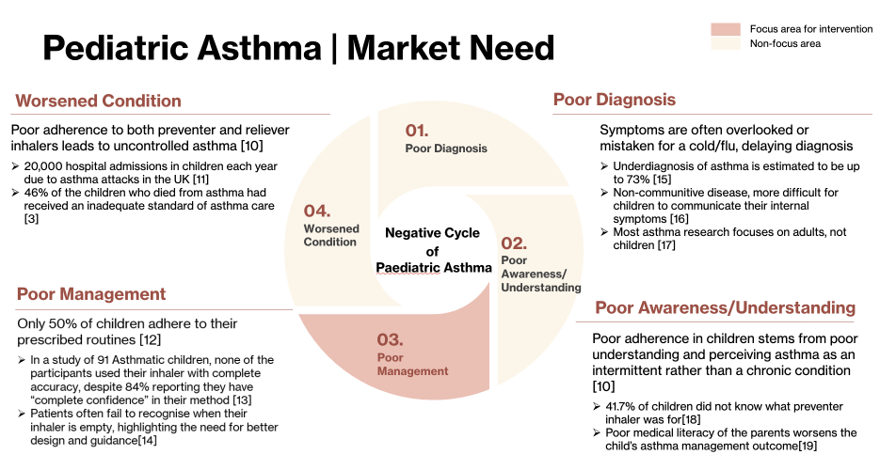
Research
Ideation
Concept
Collaborated Effort:

Slide 3
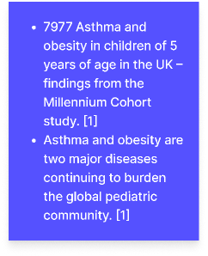
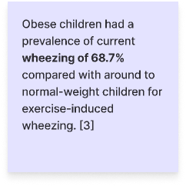
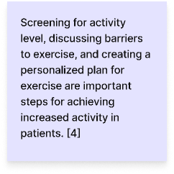
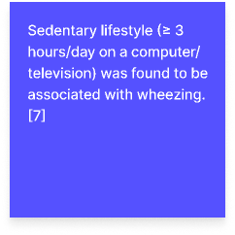
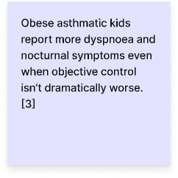
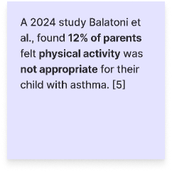
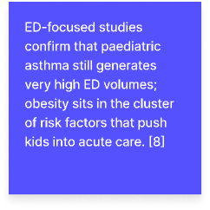
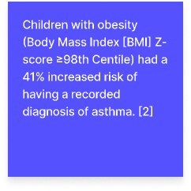
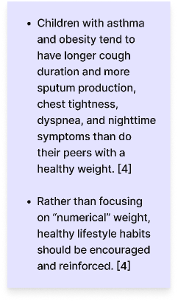
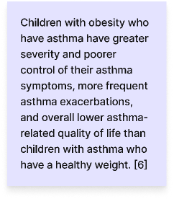
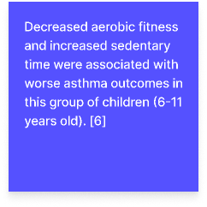
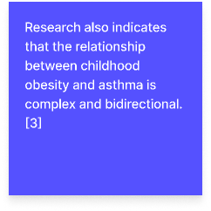
Research
Ideation
Concept
Individual
Problems:
For Asthmatic Obese children
Obese kids with asthma tend to have worse control / more exacerbation.
These exacerbation = breathlessness, chest tightness, ED use.​
Symptoms + fear → activity restriction → Sedentary behavior.​
Parental concern → Over-protection + Inducing fear​.
Not enough emphasis or interventions on the topic

Slide 4
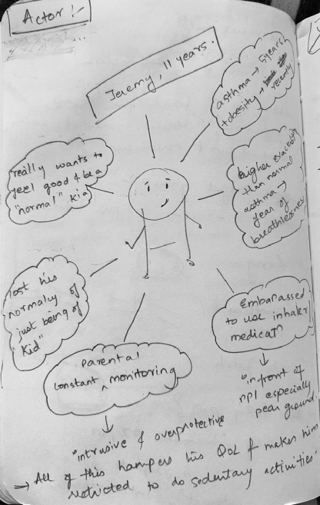
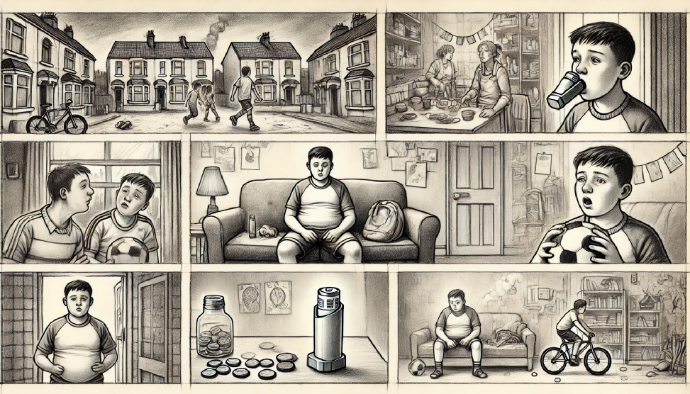
Research
Ideation
Concept
Scenario Building | Storyboard:
Phase 1: Setting user identity
Phase 2: User Context
(AI generated sketch), DALLE
Jeremy, an 11-year-old boy from a modest London suburb, has lived with asthma since age 5 and is now borderline obese.
His weight and asthma have severely affected his confidence and participation in school activities.
He avoids using his inhaler in public due to stigma, often sitting out of games to hide his condition.
His overprotective mother limits his playtime out of fear of exercise-induced asthma attacks.
Long waits for pediatric asthma reviews mean outdated care plans, leading the family to rely on emergency visits instead of consistent management.

Slide 5
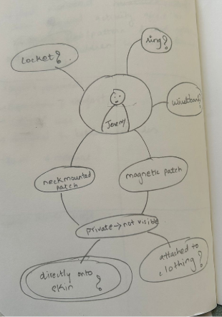
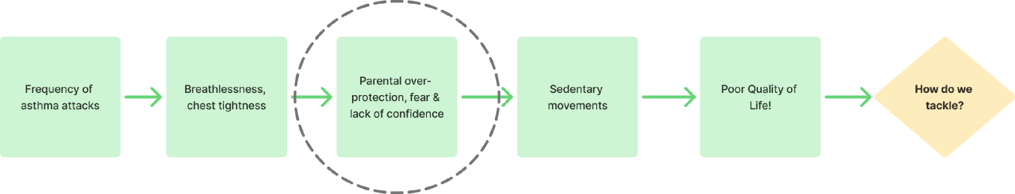
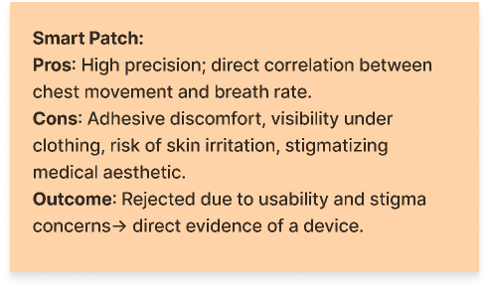
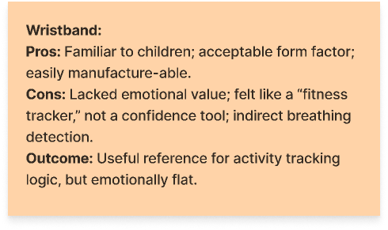
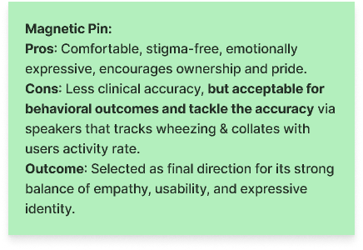
Research
Ideation
Concept
Concept Generation:
Option 1:
Option 2:
Option 3:

Slide 6
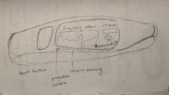
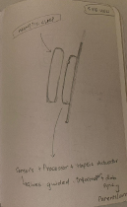
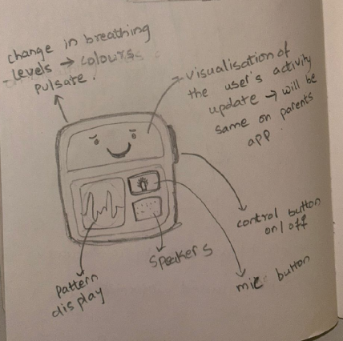
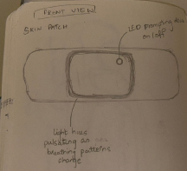
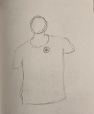
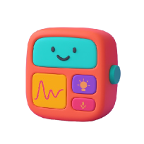
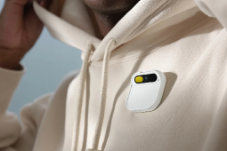
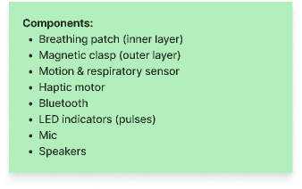
Research
Ideation
Concept
Product → AESTHESITY
Is a compact wearable system designed to support children with obesity-linked asthma by promoting confident, independent breathing management. The product consists of two connected components: a soft, skin-safe breathing patch placed on the chest and a magnetic outer clasp worn over clothing. Ensuring accurate breathing detection while maintaining comfort and a non-medical appearance.​
Functions:
Sketch to Design:
Final
Physical Activity Monitoring: Physical activity and breathing patterns.​
Assess Breathing Patterns: Subtle haptic & sound feedback.
Parent- Child: Co-activity and breathing sessions through the connected app.
Iterations
Safe Escalation Alert: If breathing remains irregular, GP and carer.​
AI Generated: DALLE
Reference: Humane AI

Slide 7
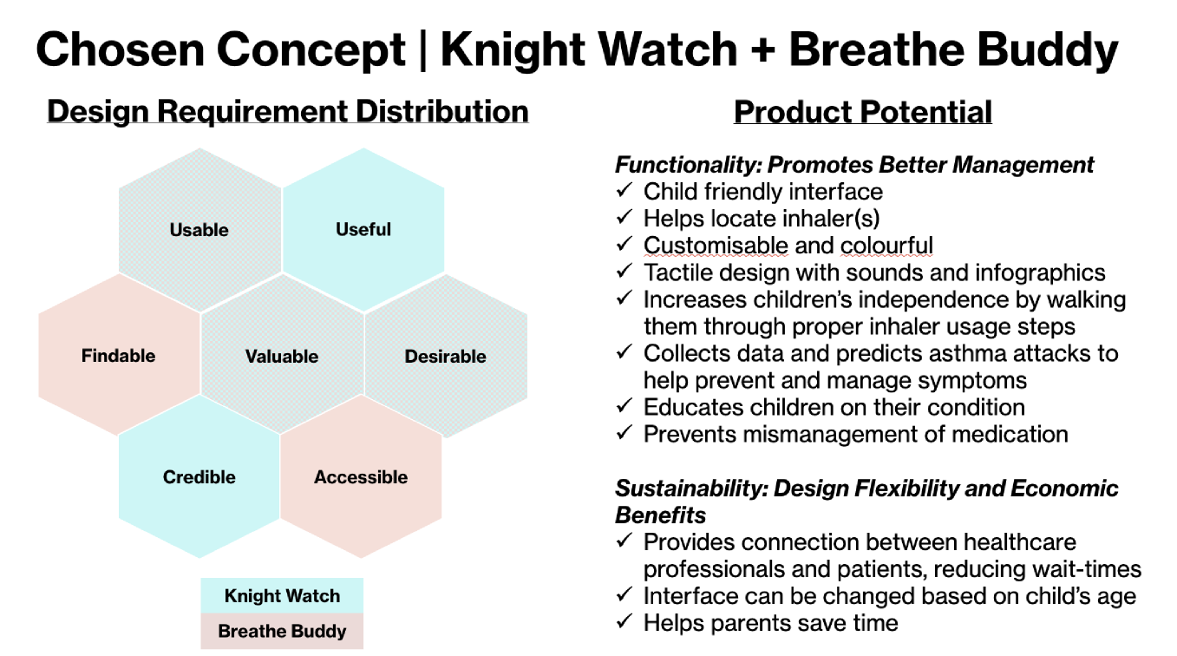
Research
Ideation
Concept
Final Concept (As a group)

Slide 8

References (Individual):
[1] ”Asthma and obesity in children of the UK”, https://adc.bmj.com/content/110/Suppl_1/A118.abstract
[2] “Early childhood obesity and subsequent asthma diagnoses”, https://ijpds.org/article/view/2374
[3] “Childhood patterns of overweight and wheeze and subsequent risk of current asthma and obesity in adolescence”, https://onlinelibrary.wiley.com/doi/10.1111/ppe.12760
[4] “Management of the pediatric patient with asthma and obesity”, https://www.annallergy.org/article/S1081-1206(23)01301-7/fulltext
[5] “Assessment of the Physical Activity of Children with Asthma Bronchiale”, https://www.mdpi.com/2075-4663/12/4/114
[6] “Obesity-related asthma in children and adolescents”, https://www.thelancet.com/journals/lanchi/article/PIIS2352-4642(22)00185-7/abstract
[7] “Current lifestyle and risk for asthma: Sedentary lifestyle, obesity, and ETS”, https://pubmed.ncbi.nlm.nih.gov/40682245/
[8] “Body mass index and acute asthma severity among children presenting to the emergency department”, https://onlinelibrary.wiley.com/doi/10.1111/j.1399-3038.2009.00911.x

Slide 9
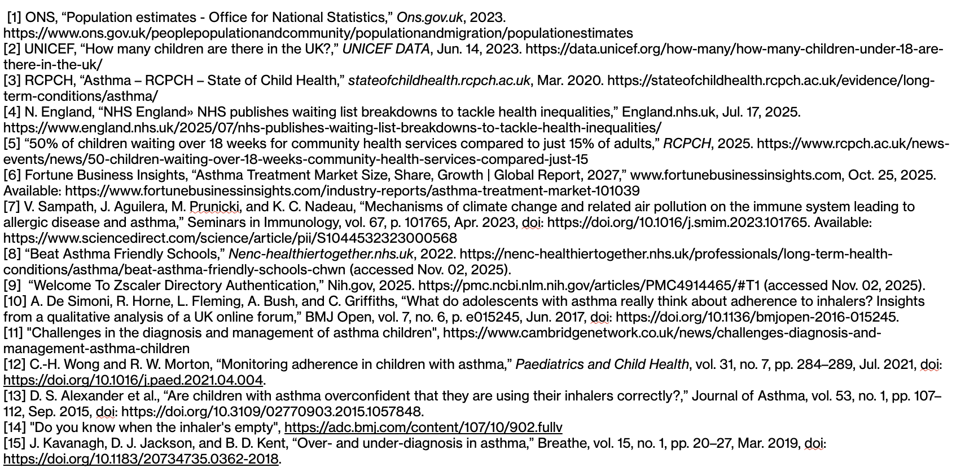
References (Group):

Slide 10
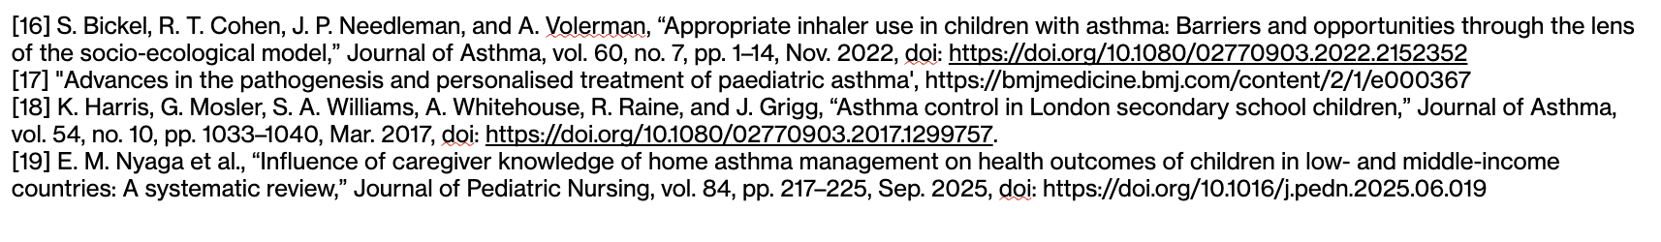
References (Group):

